Slide 1
Welcome to (the end of) CSE 142!
Ana Jojic
Summer 2022

Slide 2
You Made It!

Slide 3
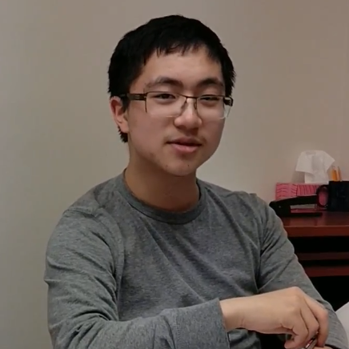
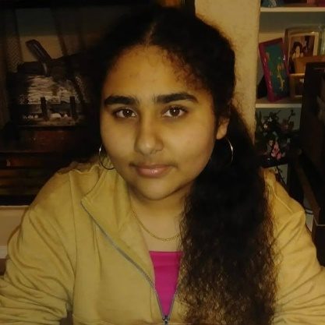
Thank your TAs!!
Notes:
UPDATE ME

Slide 4
Learning Objectives
or “What will did I learn in this class?”
Functionality/Behavior: Write functionally correct Java programs that meet a provided specification and/or solve a specified problem
Functional Decomposition: Break down problems into subproblems that are modular and reusable, and define methods to represent those subproblems
Control Structures: Select and apply control structures (e.g. methods, loops, conditionals) to manage the flow of control and information in programs
Data Abstraction: Select and apply basic data abstractions (e.g. variables, parameters, arrays, classes) to manage and manipulate data in programs
Code Quality: Define programs that are well-written, readable, maintainable, and conform to established standards

Slide 5
(Partial) Topic List
or another view on “What did I learn in this class?”
Methods
Parameters
Return Values
Variables
Types
Loops (for and while)
Conditionals
Console (User) I/O
File I/O
Arrays
Classes
Inheritance
ArrayList
Many common algorithms!

Slide 6
Underlying Skills
or “What did I learn in this class without realizing it? What skills can I apply anywhere else?”
Computational thinking: breaking problems down into smaller, well-defined steps that can be recombined
“Thinking like a computer” (Also called algorithmic thinking)
Testing: determining whether or not a program works as expected
Requires really knowing what “as expected” means
Debugging: finding and fixing errors in existing code
Often just as hard (or harder!) than writing the code in the first place

Slide 7
Learning in CSE 142 (or anywhere)

Slide 8
Applications of CS
or “What can I do with what I learned?”
Detect and prevent toxicity online
Digitize basketball players
Help DHH people identify sounds
Figure out how to best distribute relief funds
Recognize disinformation online
Make movies
Improve digital collaboration
Fix Olympic badminton
And so much more!

Slide 9
Future Courses
or “What can I do next?”
Course | Overview
CSE 143 * + | Intermediate programming with data structures (Java) – object-oriented
CSE 122 * + (new) | Intermediate programming with data structures (Java) – client-based
CSE 154 * + | Introduction to web programming (several languages)
CSE 160 * + | Introduction to programming for data analysis (Python)
CSE 163 + | Intermediate programming for data analysis (Python)
CSE 180 * + | Introduction to data science (Python)
* Offered in Fall 2022
+ Offered in Winter 2022 (for CSE 180 under INFO and STAT)
See also: https://www.cs.washington.edu/academics/ugrad/nonmajor-options/intro-courses
For info on new 12x series: https://www.cs.washington.edu/academics/ugrad/nonmajor-options/cse12x

Slide 10
More Java?
With CSE 142 knowledge
If you want more practice with writing programs before you start implementing objects and don’t mind using 2 quarters to finish the new intro series
Take the adaptive self-placement quiz: https://placement.cs.washington.edu/
CSE 122 (Fall 2022, and onward)
Content covered includes:
Program design, style, and documentation
Interfaces vs Implementation
Data-structures use (including lists, stacks, queues, sets, maps)
Assumes basic programming knowledge
New course with its own set of guidelines
Recommended if you started with 142
CSE 143 (at minimum Fall 2022 – Spring 2023)
Content covered includes:
Object-oriented design, style, and documentation
Inheritance vs Interfaces
Data-structures use and implementation (lists, stacks, queues, sets, maps, trees, priority queues)
Run-time complexity
Basic search and recursive algorithms
Uses same textbook as 142, continues where 142 leaves off (with ArrayList)
Uses very similar style guidelines to 142
With CSE 122 knowledge
CSE 123 (Winter 2022, and onward)
Content covered includes:
Object-oriented design, style, and documentation
Inheritance vs Interfaces
Implementation of data structures (including the above + linked references and trees)
Run-time complexity
Basic search and recursive algorithms
New course with its own set of guidelines

Slide 11
Frequently Asked Questions
How can I get better at programming?
Practice!
How can I learn to X?
Search online, read books, look at examples
What should I work on next?
Anything you can think of! (Here are some ideas)
Beware: it’s hard to tell what’s easy and what’s hard.
Should I learn another language? Which one?
That depends– what do you want to do?
What’s the best programming language?
😠 (take CSE 341)

Slide 12
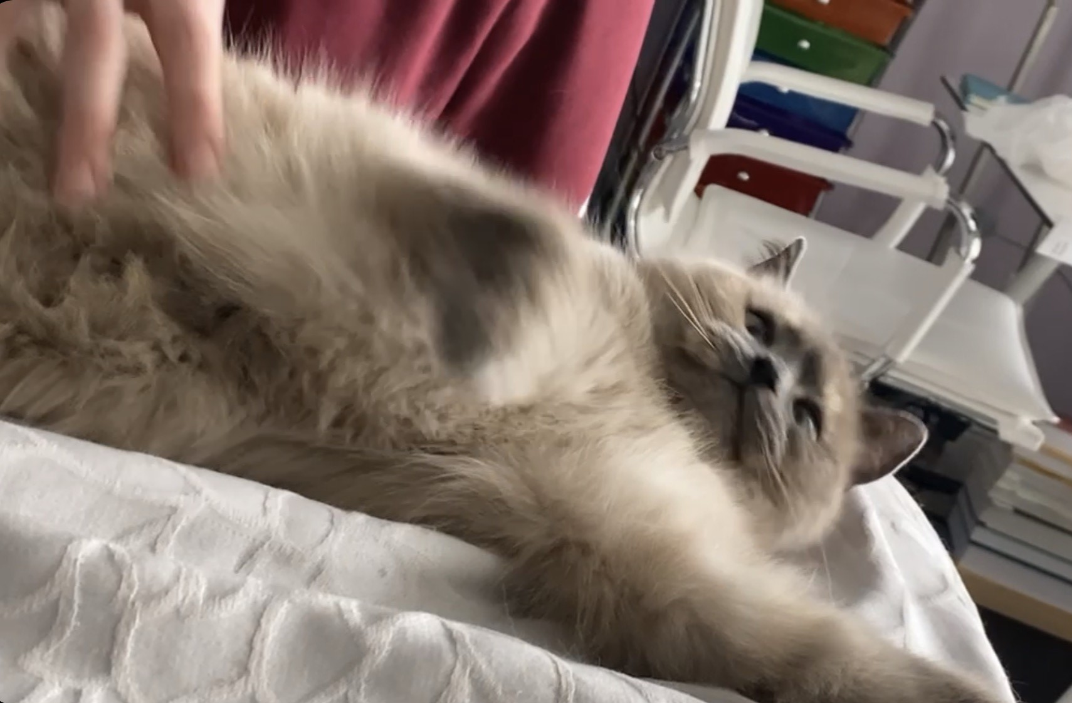
Thank you!!!

